Slide 1
Battery Drain Issue
-Manoj Reddy
-Omkar Salunke
-Kavya Kumar Vallurupalli
-Rohan Girase

Slide 2
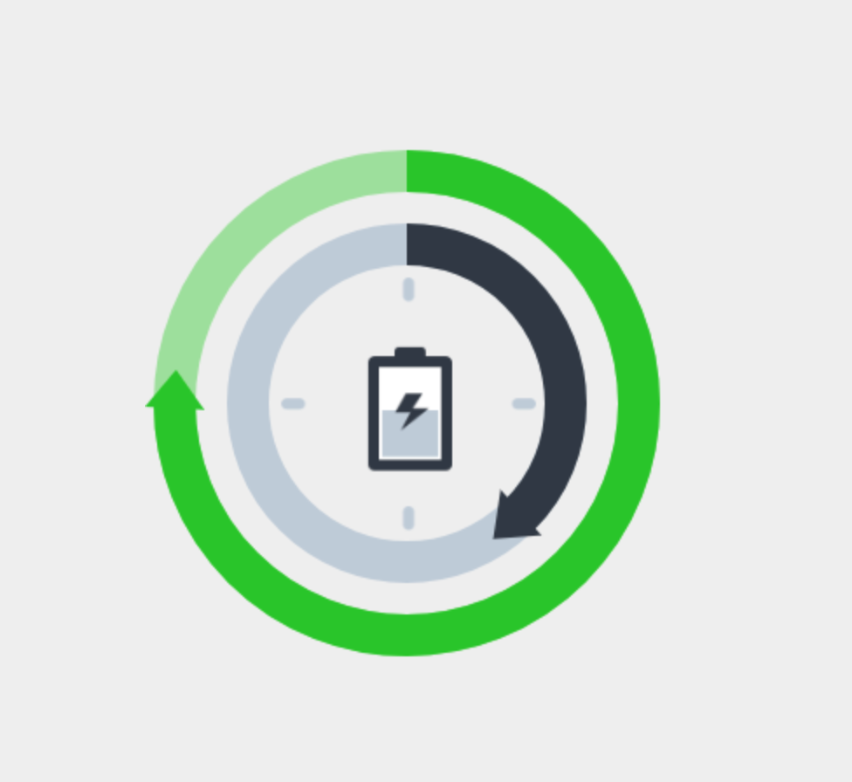
Usability Testing:
Battery Doctor
Battery doctor can extend the standby time of your phone. Over 100 million users have found the benefits of its intelligent power saving, accurate power remaining forecasting, and professional charging capabilities.

Slide 3
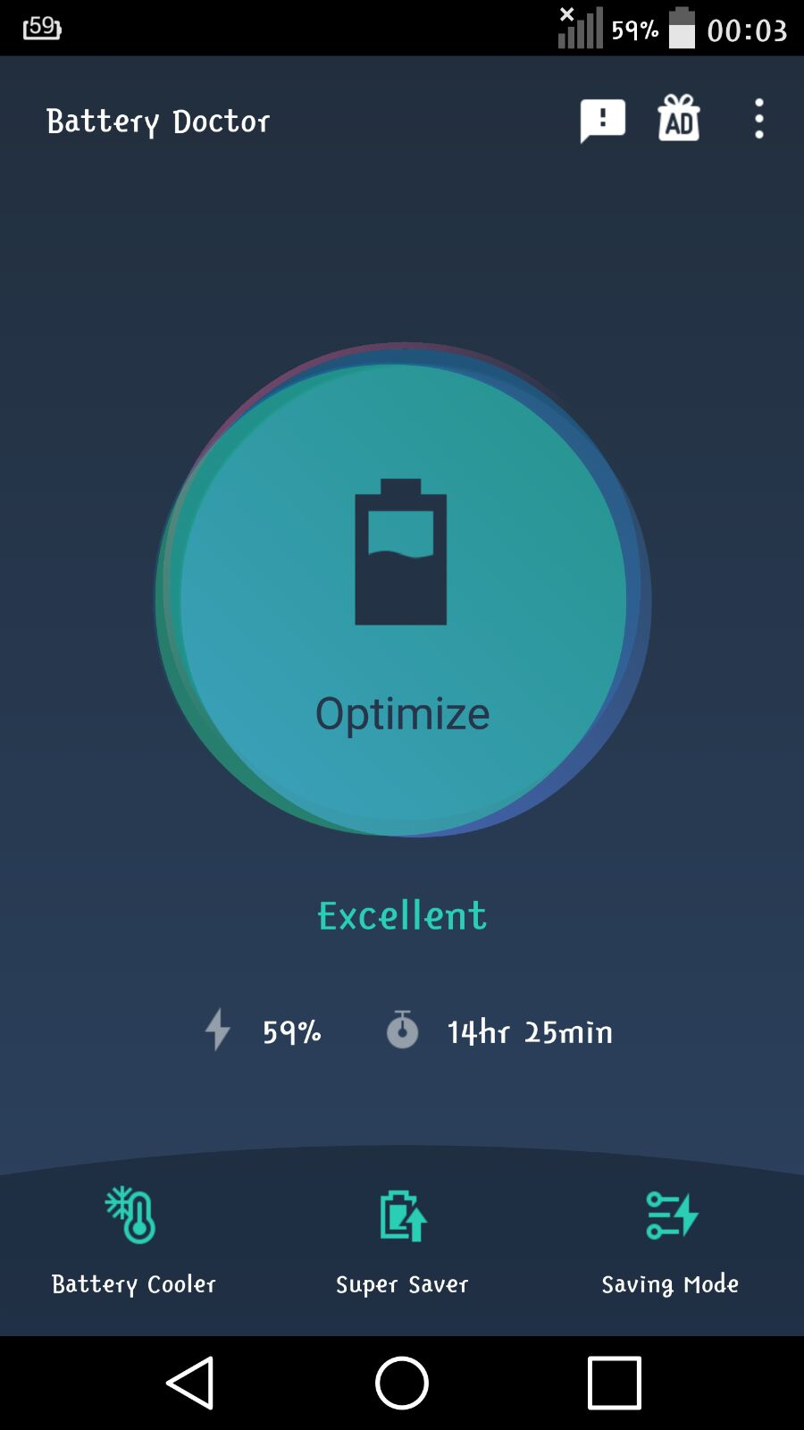
Think Aloud Tasks:
1: Open the App and Figure out Settings to choose a particular power saving mode.
2: Browse through various details about battery usage and turn on super saver mode.
3: Navigate to battery cooler menu and cool down the battery to see any performance changes

Slide 4
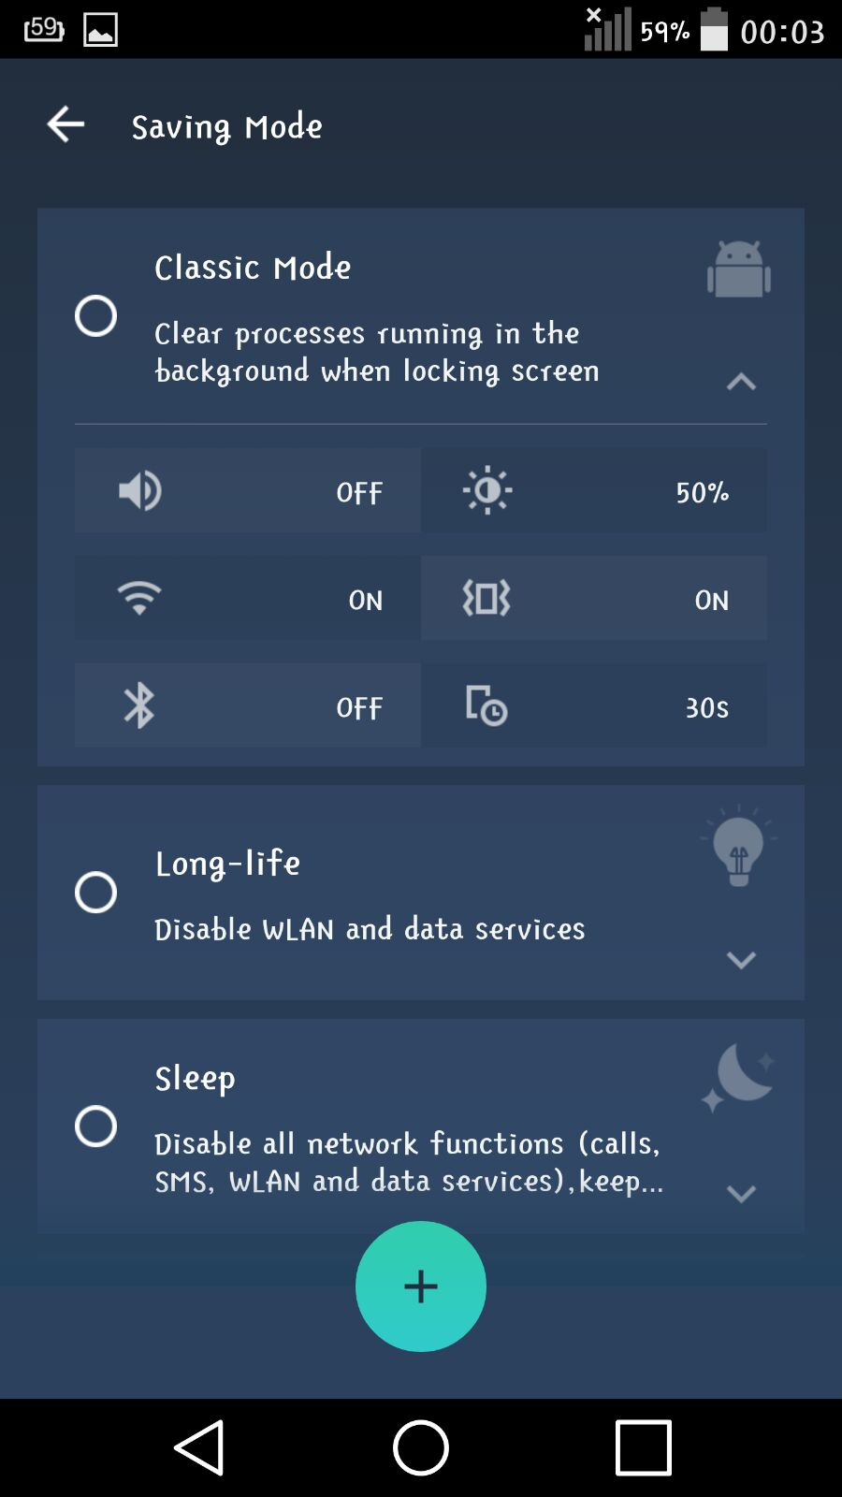
Results:
Task 1:
There were three modes in Saving mode by default: Long-life, classic and Sleep.
Has options to choose and has details clearly shown.
Users could also add a customized mode according to their requirements.

Slide 5
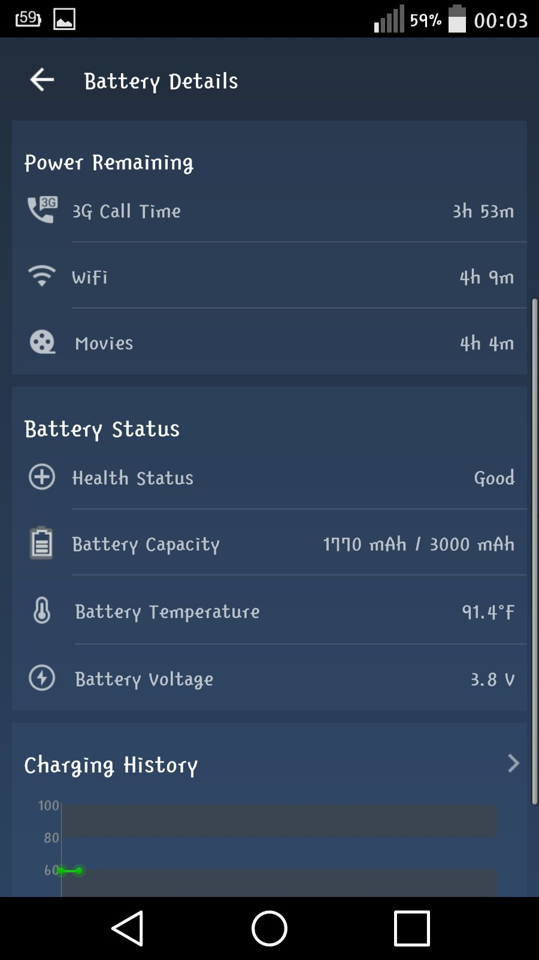
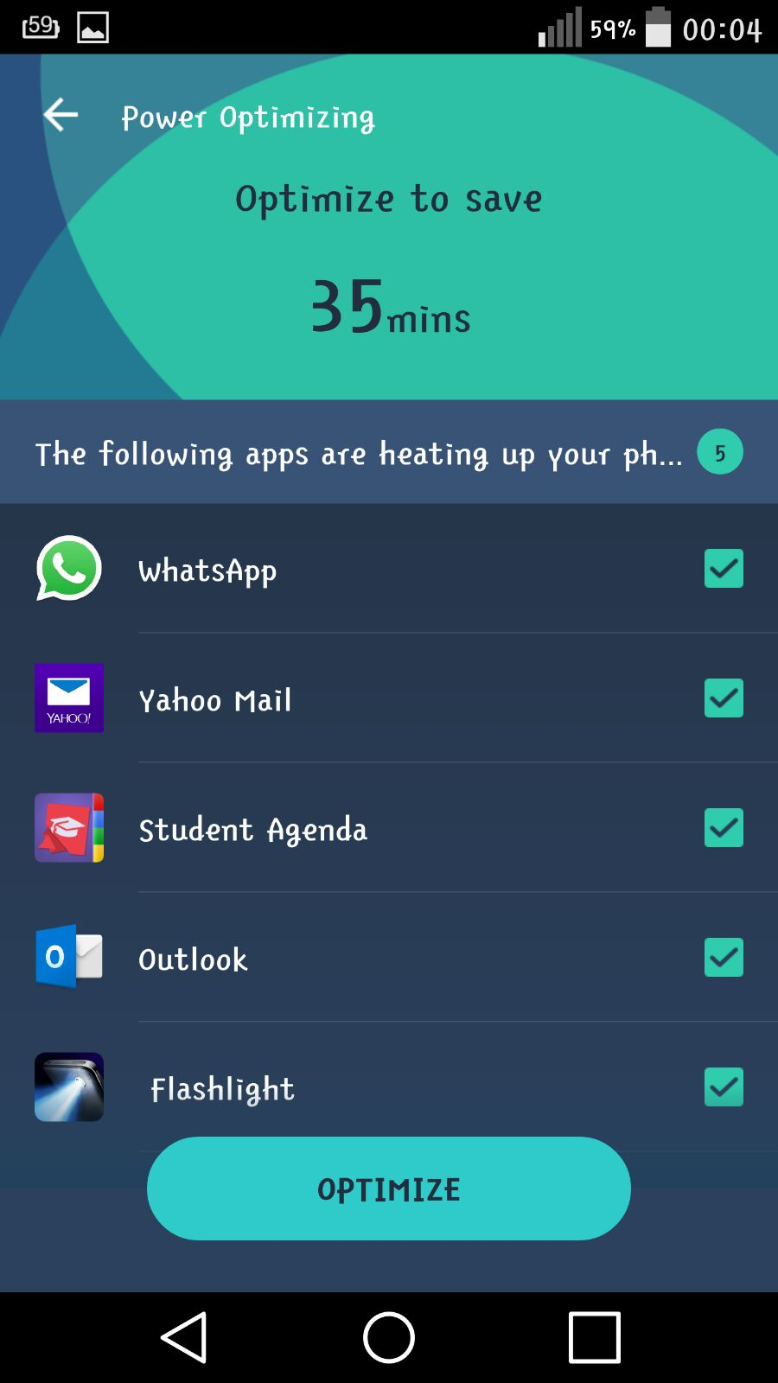
Results:
Task 2:
Users were asked to Discover about super saver mode.
This mode gave Detailed analysis of apps consuming lot of power and cellular data.
The battery details page has good information which is helpful to analyze the remaining battery and how long it can run.

Slide 6
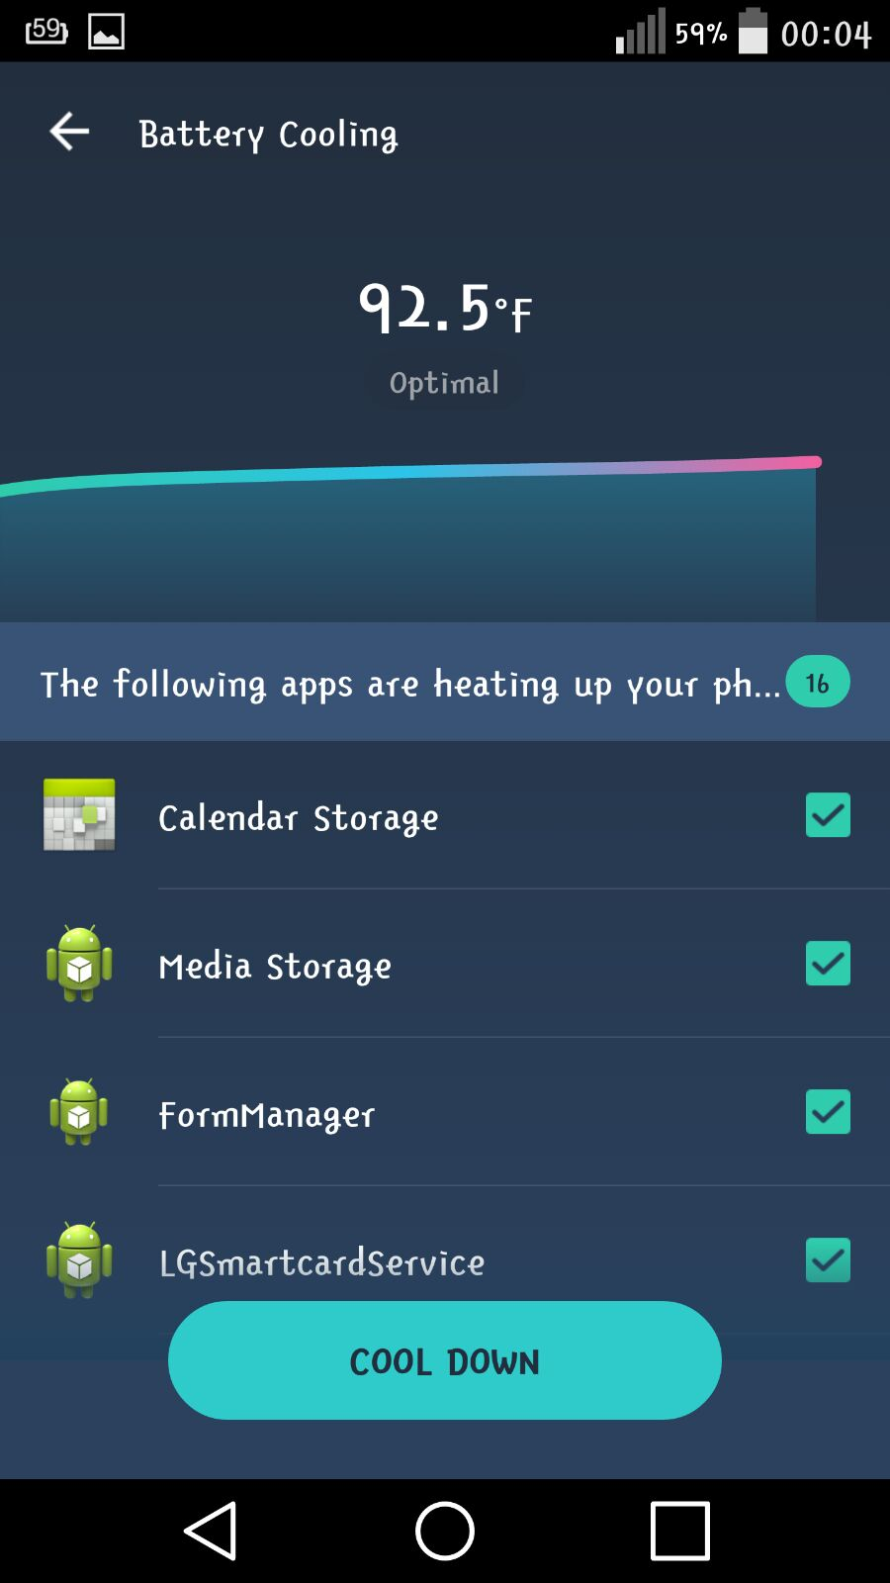
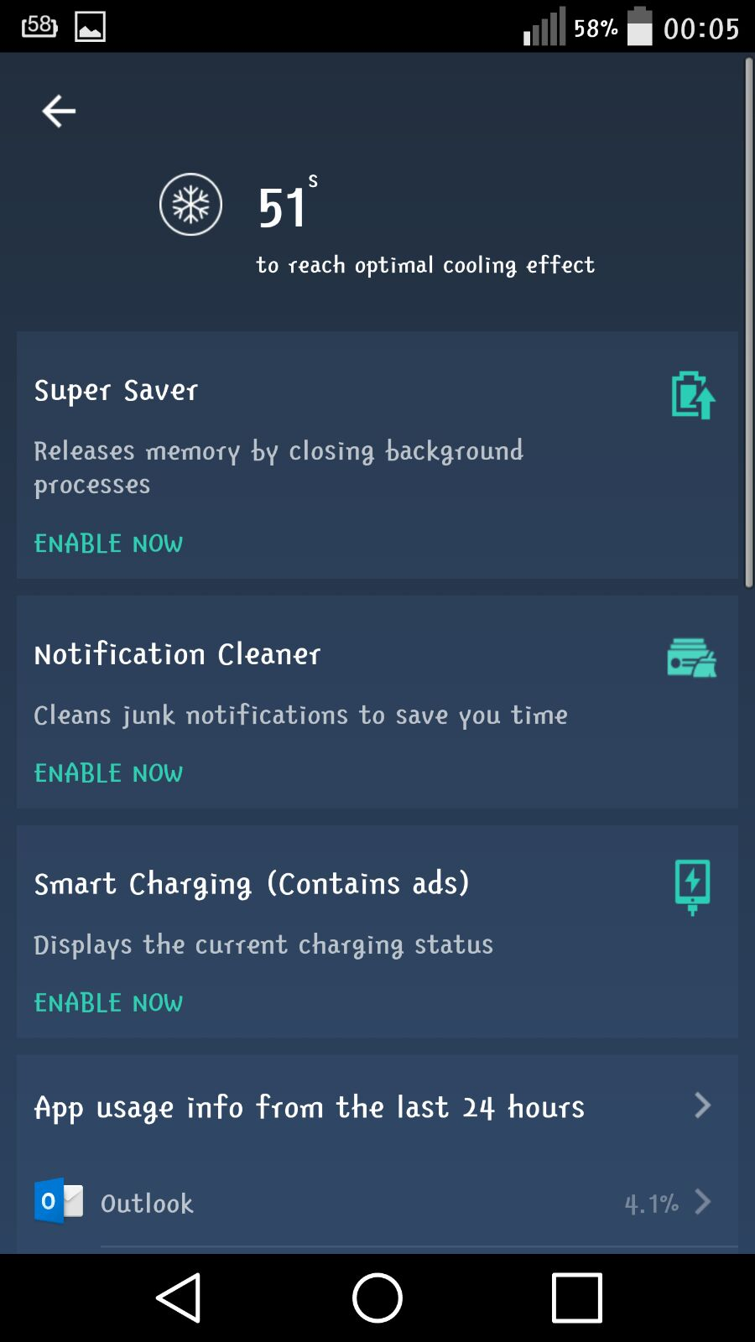
Results:
Task 3:
Battery Cooler mode was Tested in this task.
This mode cooled down battery by by shutting down apps and clearing memory by shutting down apps running in background.
However, most users found this mode similar to Super saver mode

Slide 7
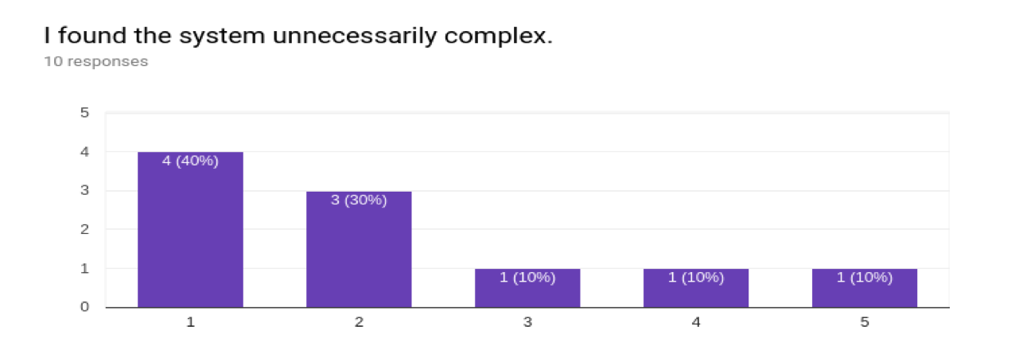
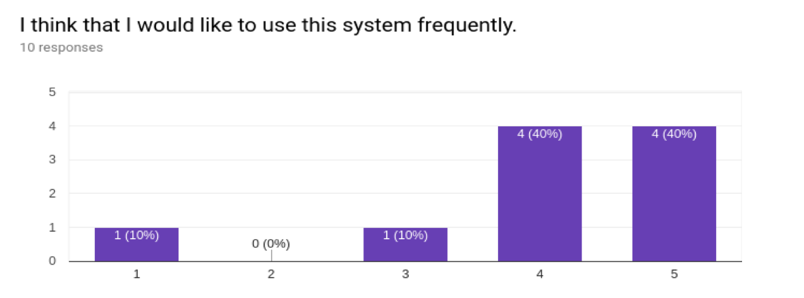
SUS Survey Results:

Slide 8
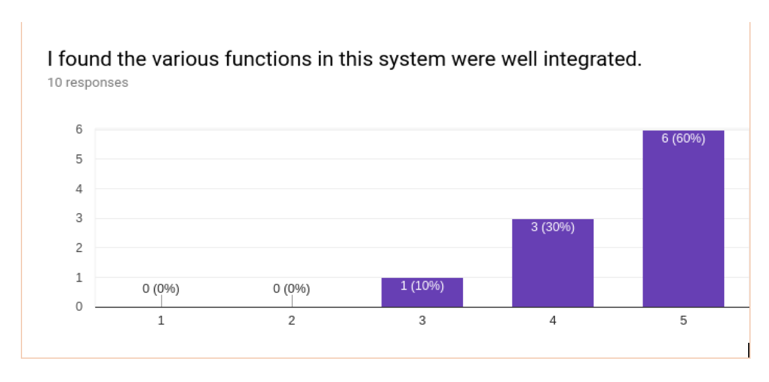
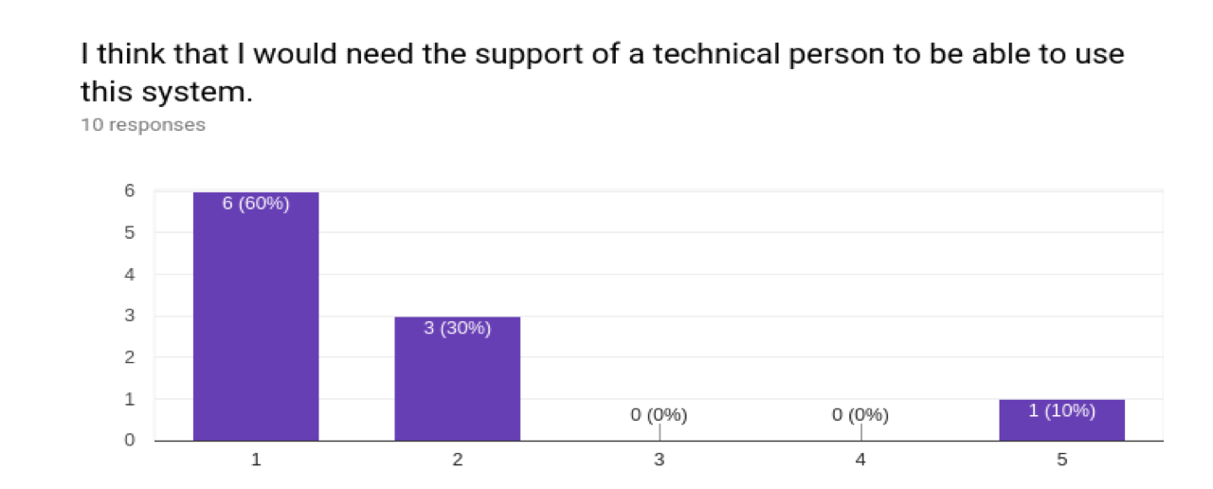
SUS Survey Results:

Slide 9
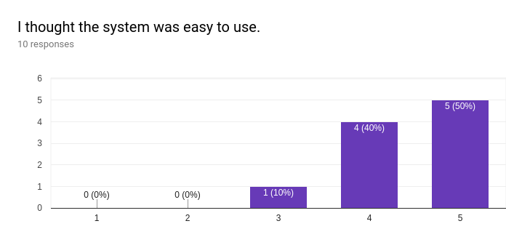
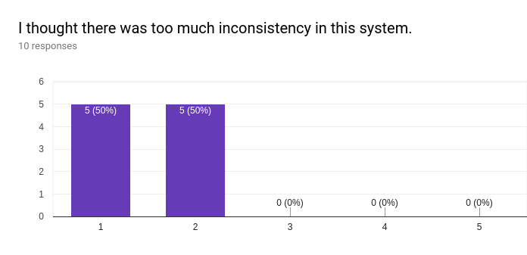
SUS Survey Results:

Slide 10
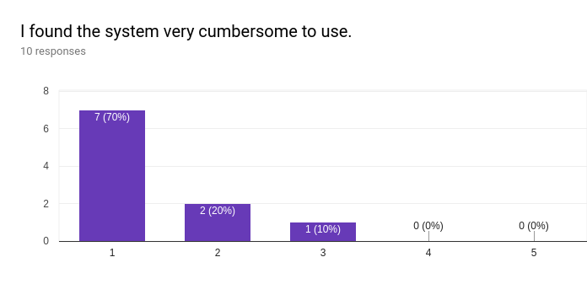
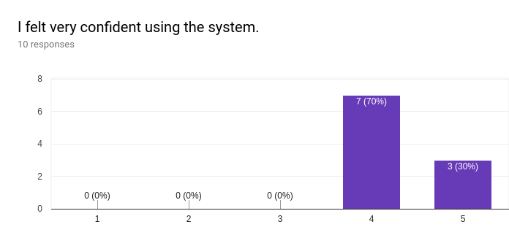
SUS Survey Results:

Slide 11
Interview Questions
Do the user interface is easy to use and simple looking?
Does this application solves the problem?
Are the tasks are fair enough to learn about the application?
How much percent are you willing to use this application?
Do you think of any changes that can be done in application to be more user friendly?

Slide 12
Conclusion
All the participants found the application user friendly and appreciated the simple UI.
Many participants thought that the application can solve the problem of battery issues with the phone.
The tasks covered the major functionalities of the application. So participants became comfortable with application after finishing think aloud tasks.
About 90% of participants are willing to use this application.

